Slide 1
Comp 5120 Final Presentation
Dylan McCardle

Slide 2
Project Overview
Project goal was to create a MySQL database using the provided data and then create a web interface that would allow a use to change that data.
Technologies used:
MySQL: HeidiSQL, Putty
ER Diagram and Schema: StarUML, lucidchart

Slide 3
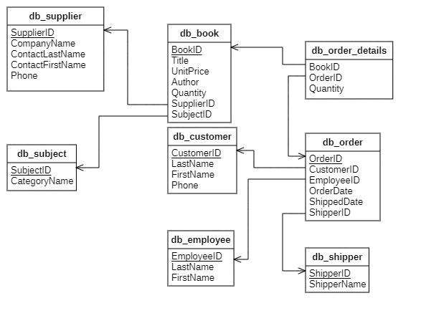
Schema Diagram

Slide 4
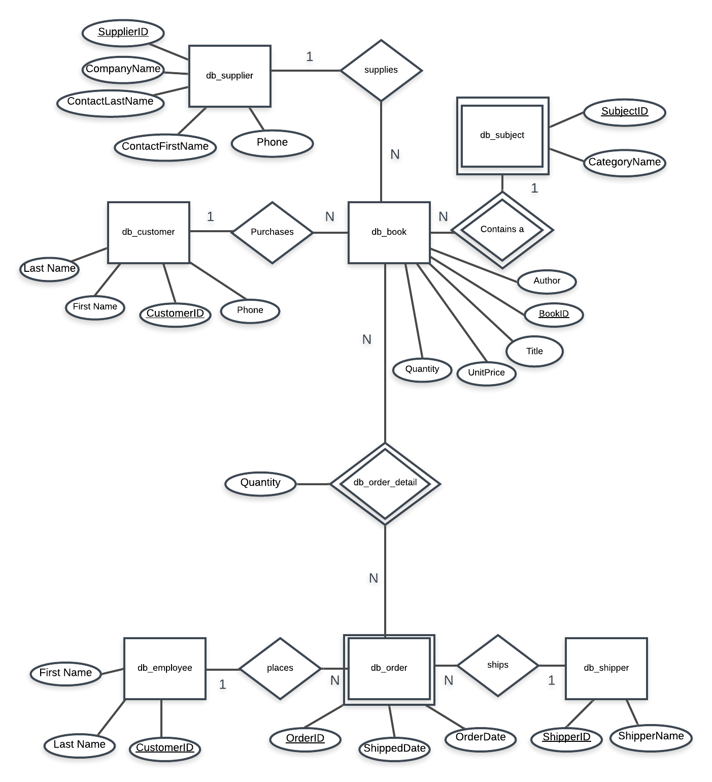
ER Diagram

Slide 5
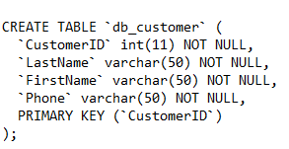
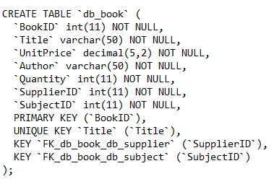
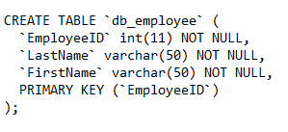
CREATE TABLE statements

Slide 6
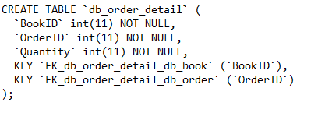
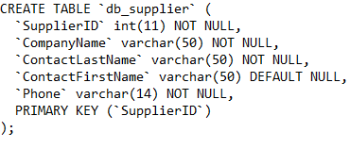

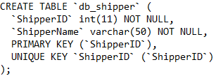
CREATE TABLE Statements

Slide 7
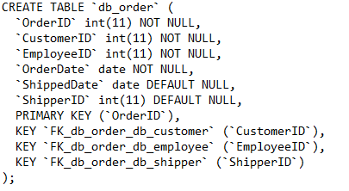
CREATE TABLE Statements

Slide 8
Demonstration
Using SQL fiddle as I could not get my website to function

